Slide 1


HOSPITAL MANAGEMENT SYSTEM WITH C#: DATABASE DESIGN AND IMPLEMENTATION
Kerem İzgüden
No: 20210205302
Supervisor: Prof. Dr. Yıldıray Yalman

Slide 2

INTRODUCTION & PROJECT SCOPE
This project aims to digitize internal hospital operations through a secure and modular software solution.
The system manages patient registration, doctor scheduling, appointment coordination, prescription issuance, and stock tracking.
It is designed for administrative staff, medical personnel, and support units, allowing them to operate efficiently through role-specific panels.

Slide 3
TECHNOLOGIES & ARCHITECTURE
C# Windows Forms – Desktop UI for all roles
Microsoft SQL Server – Relational database for secure storage
AES Encryption – Data protection for sensitive fields
SMTP Email – Automated appointment confirmation emails
.NET Framework – Application backbone

Slide 4

USER LOGIN & SECURITY
Users log in with their credentials and are directed to their role-specific panels.
Each login is verified for correctness, and empty field checks are performed.
To prevent brute force attacks, the system temporarily locks the login after 5 failed attempts.
A cooldown timer resets after 1 minute, enhancing system security.
All credentials are AES encrypted and matched securely in the database.

Slide 5
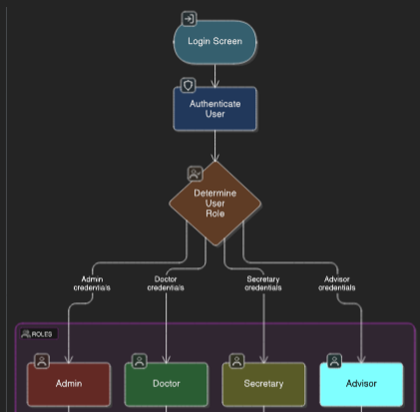
ROLE-BASED NAVIGATION
After successful login, users are redirected to their designated panel based on their role:
Admin → Full access to all modules
Doctor → Appointment list and calendar view
Secretary → Patient records, appointments, prescriptions
Advisory Staff → View appointments via ID search
Inventory Manager → Stock tracking and expiry management
Each role is granted only the permissions relevant to their duties.

Slide 6
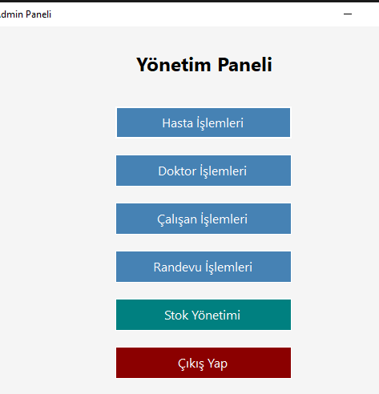
ADMIN PANEL OVERVIEW
The Admin Panel serves as the control center of the system.
It provides access to all major modules:
Patient Management
Doctor Management
Appointment Scheduling
Staff Records
Inventory (Stock) System
Admins can monitor, add, update, or remove records across all modules.

Slide 7
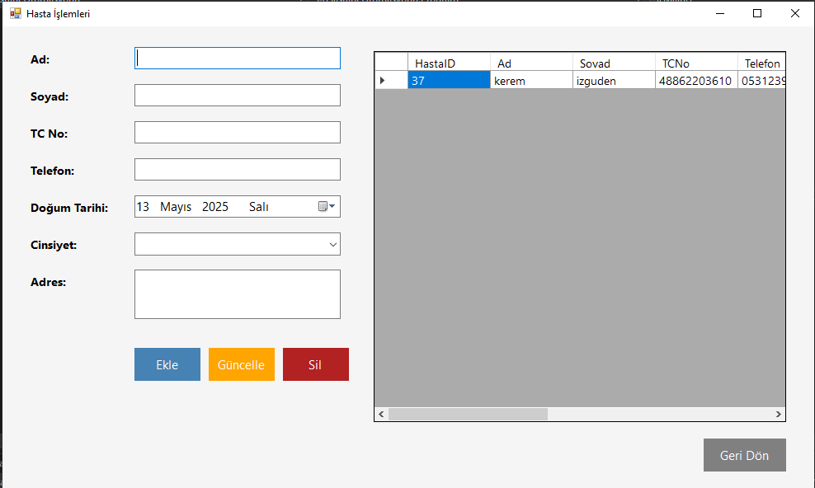
PATIENT MANAGEMENT
Patient registration includes full identity, contact, and demographic data:
Name, Surname, National ID, Phone, Address, Gender
National ID is validated with a 11-digit control algorithm
All sensitive data is AES encrypted before being stored in the database
The secretary or admin can add, update, or delete patient records securely.

Slide 8
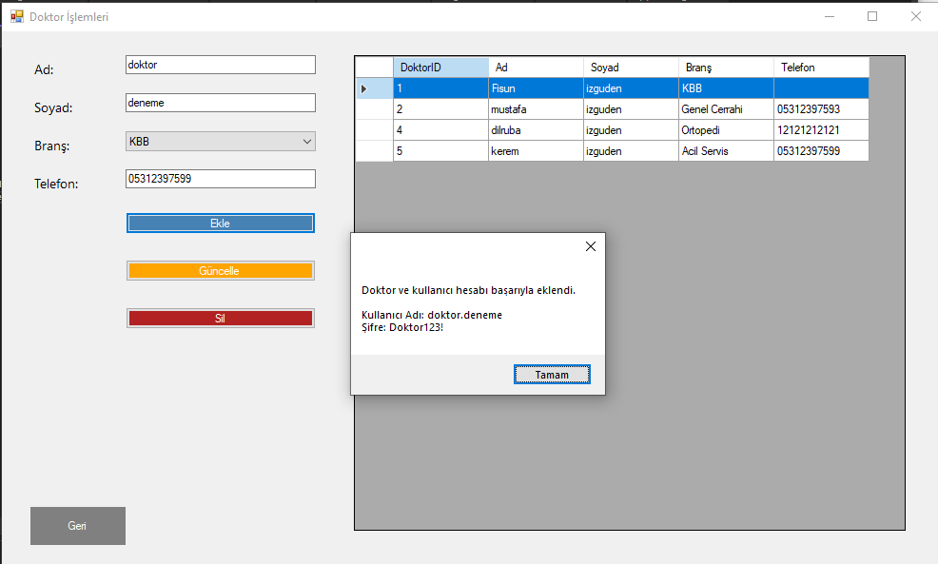
DOCTOR MANAGEMENT
The system allows adding and managing doctors along with their specialties:
Name, Surname, Branch, and Contact Number
Branch is selected from predefined medical categories
Sensitive fields are AES encrypted for privacy
Doctors are linked to their login credentials and can later view their own appointments.

Slide 9
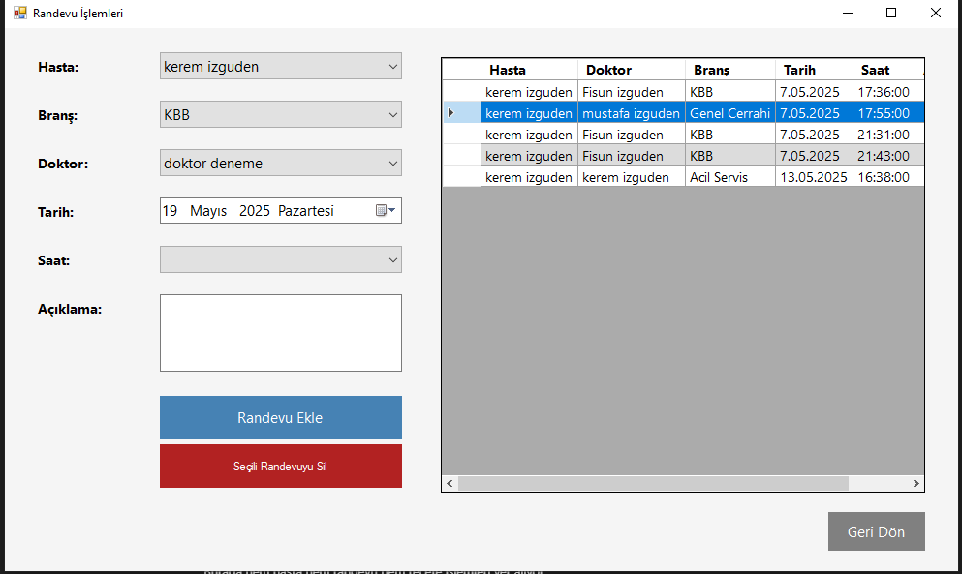
APPOINTMENT MANAGEMENT
Appointments are created by selecting the patient, doctor, date, time, and entering a note:
Patient ↔ Doctor matching based on branch
Available time slots are chosen from a predefined list
Notes are encrypted using AES and decrypted for display
Appointments are listed in real-time and can be updated or deleted as needed.

Slide 10
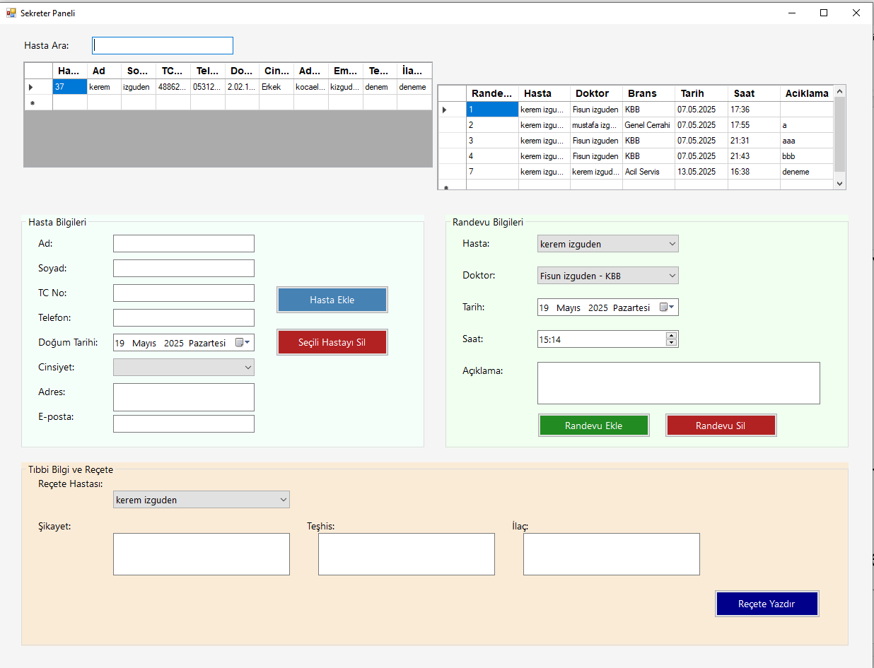
SECRETARY PANEL
The Secretary Panel combines patient and appointment management in one interface:
Add new patients with encrypted data
Schedule appointments with time/date selection
Input diagnosis, complaints, and prescriptions
An automatic email is sent to the patient upon successful appointment creation.
Prescriptions can be previewed and printed directly from the system.

Slide 11
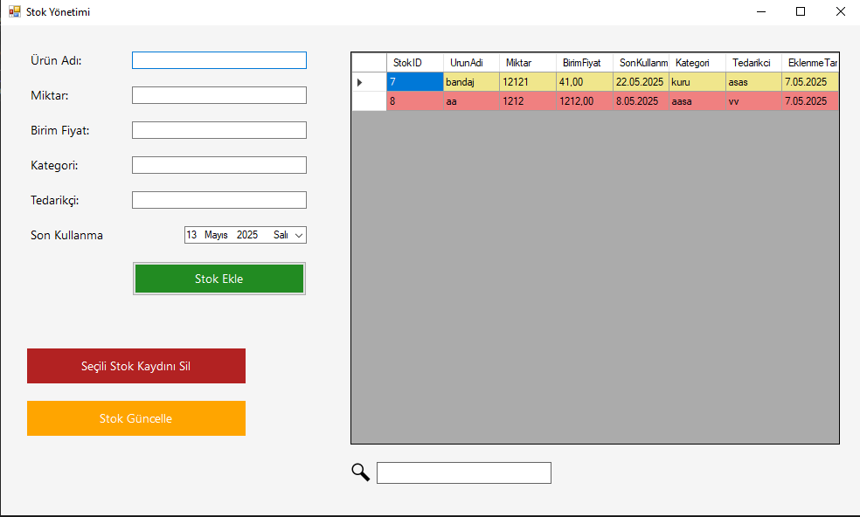
STOCK MANAGEMENT
The inventory panel allows tracking medical products with expiry alerts:
Product Name, Quantity, Unit Price, Category, Supplier
Expiration Date is monitored and color-coded:
→ Yellow: 15 days before expiry
→ Red: 7 days or less remaining
Sensitive fields like supplier and category are AES encrypted for privacy.

Slide 12
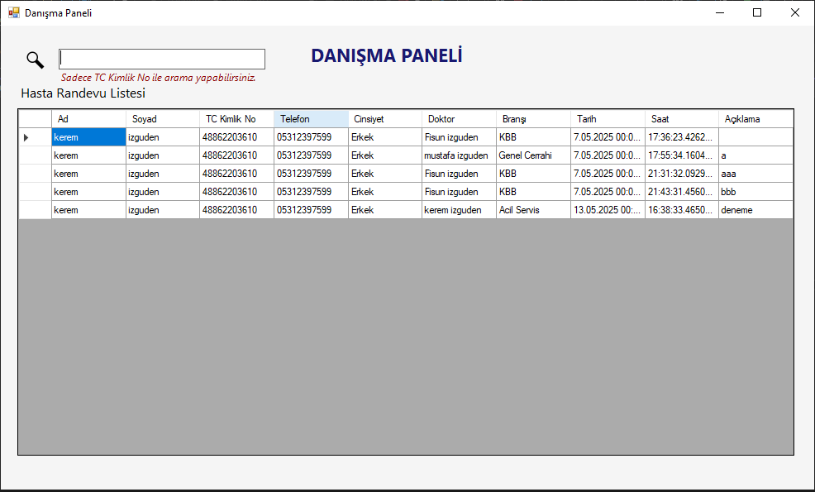
ADVISORY PANEL
Designed for front-desk staff, this panel provides quick access to patient appointment data:
Search by Turkish National ID (TC No)
View decrypted patient and appointment details
Simple and clean interface for real-time access
Only viewing is allowed — no data modification rights are granted.

Slide 13

SECURITY & ENCRYPTION
The system incorporates multiple security layers to protect sensitive information:
AES encryption for:
→ Patients (Name, Surname, TC No, Phone, Address, Diagnosis)
→ Doctors (Name,Surname, Phone)
→ Stock (Product Name, Supplier, Category)
→ Login credentials
Brute force protection: login blocked after 5 failed attempts
Role-based access control: each user accesses only relevant modules
Input validation for critical fields (e.g., TC No, Email)
These measures ensure privacy, prevent unauthorized access, and maintain data integrity.

Slide 14
REFERENCES
[1] D. R. Stinson, *Cryptography: Theory and Practice*, 4th ed., CRC Press, 2019.
[2] I. Sommerville, *Software Engineering*, 10th ed., Pearson, 2015.
[3] M. S. Uslu, M. Kalkan and N. Baykal, “Hospital Information Systems and Software Quality,” Gazi University Journal of Engineering, vol. 25, no. 1, pp. 163–172, 2010.
[4] Microsoft Docs, “Encrypting Data in .NET,” Available: https://learn.microsoft.com/
[5] European Union, “General Data Protection Regulation (GDPR),” Available: https://gdpr.eu/
[6] S. McConnell, *Code Complete*, Microsoft Press, 2004.
[7] Visual Studio Documentation, Microsoft Developer Network
[8] NIST, “Advanced Encryption Standard (AES),” Available: https://csrc.nist.gov/publications/detail/fips/197/final

Slide 15

Thank You For Listening

